Slide 1
SPAN TTC Imaging Report
Ryan Cabeen
October 26, 2020

Slide 2
University of Iowa
Cases:
AM5396
VH1918
AM5392
(from stage 1)

Slide 3
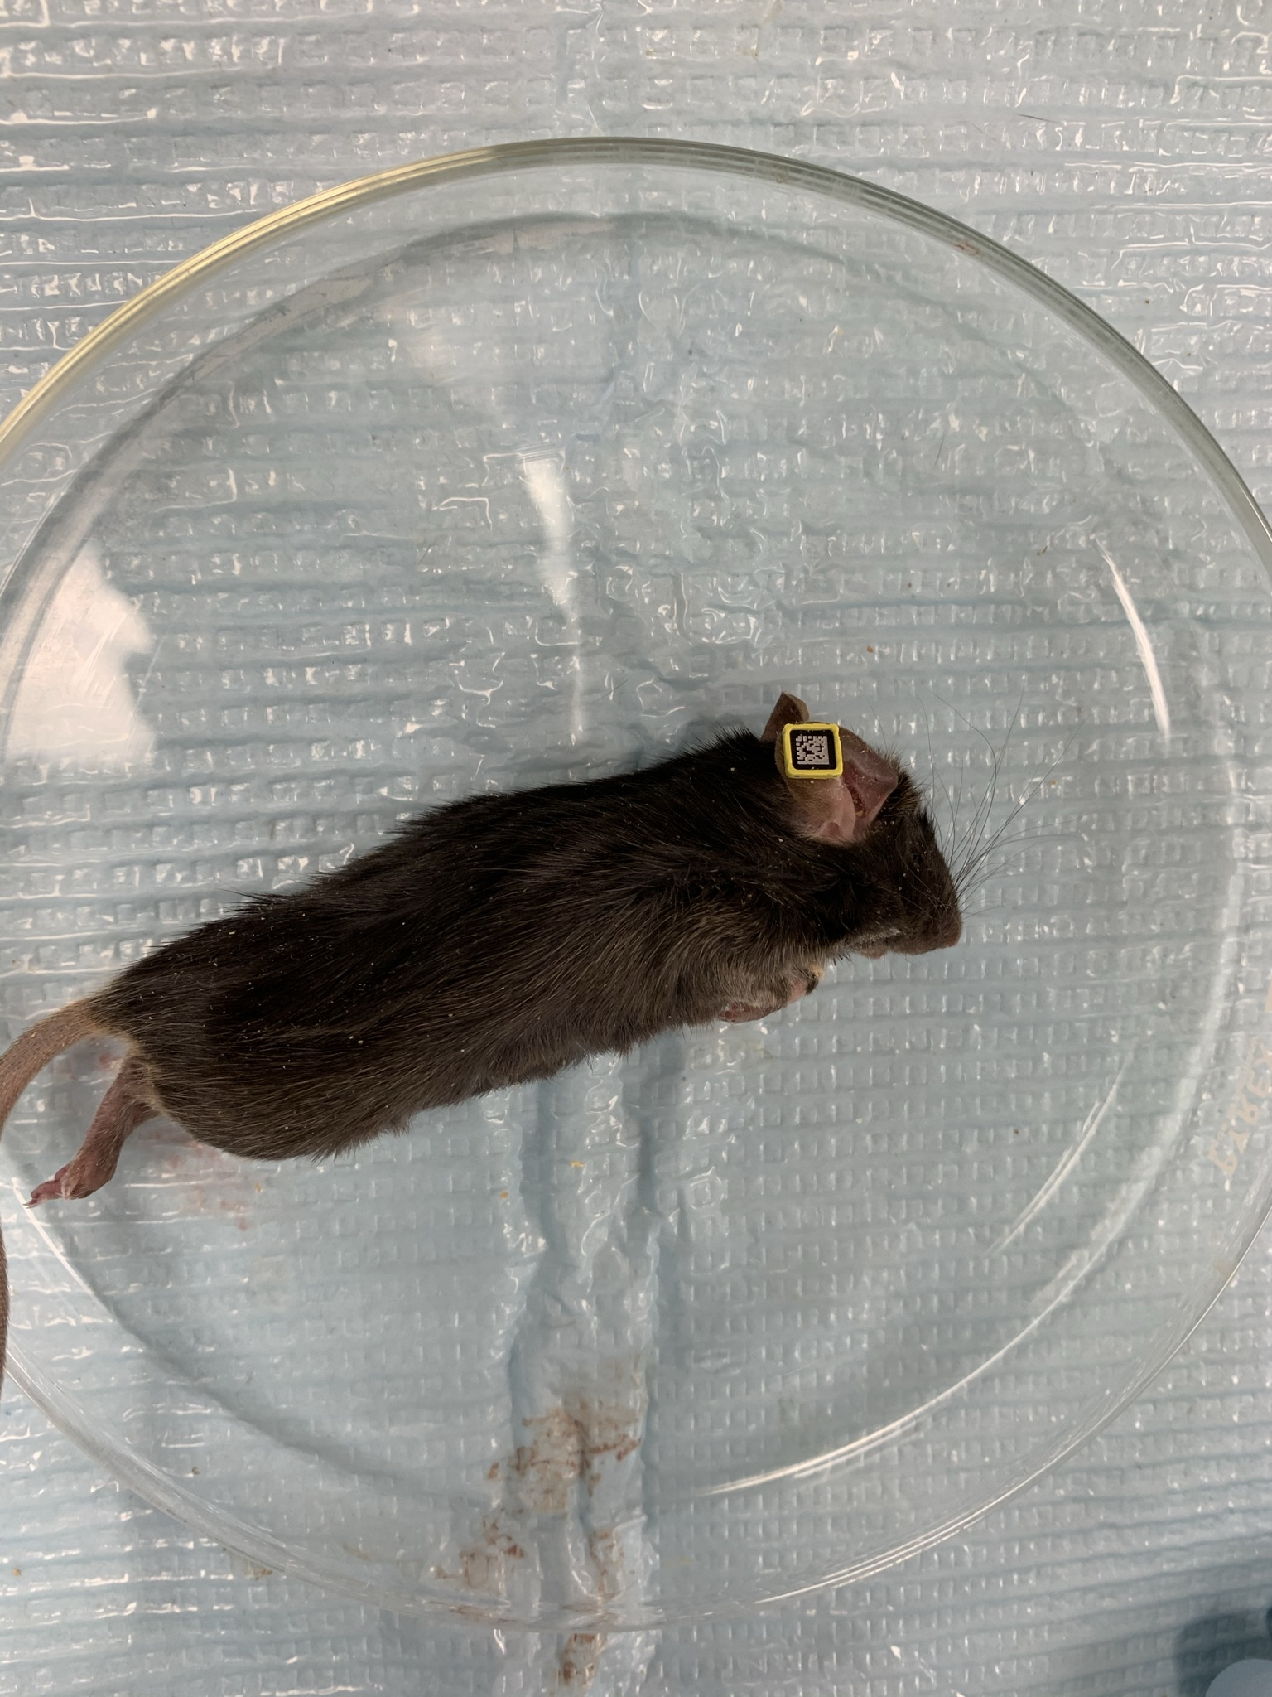
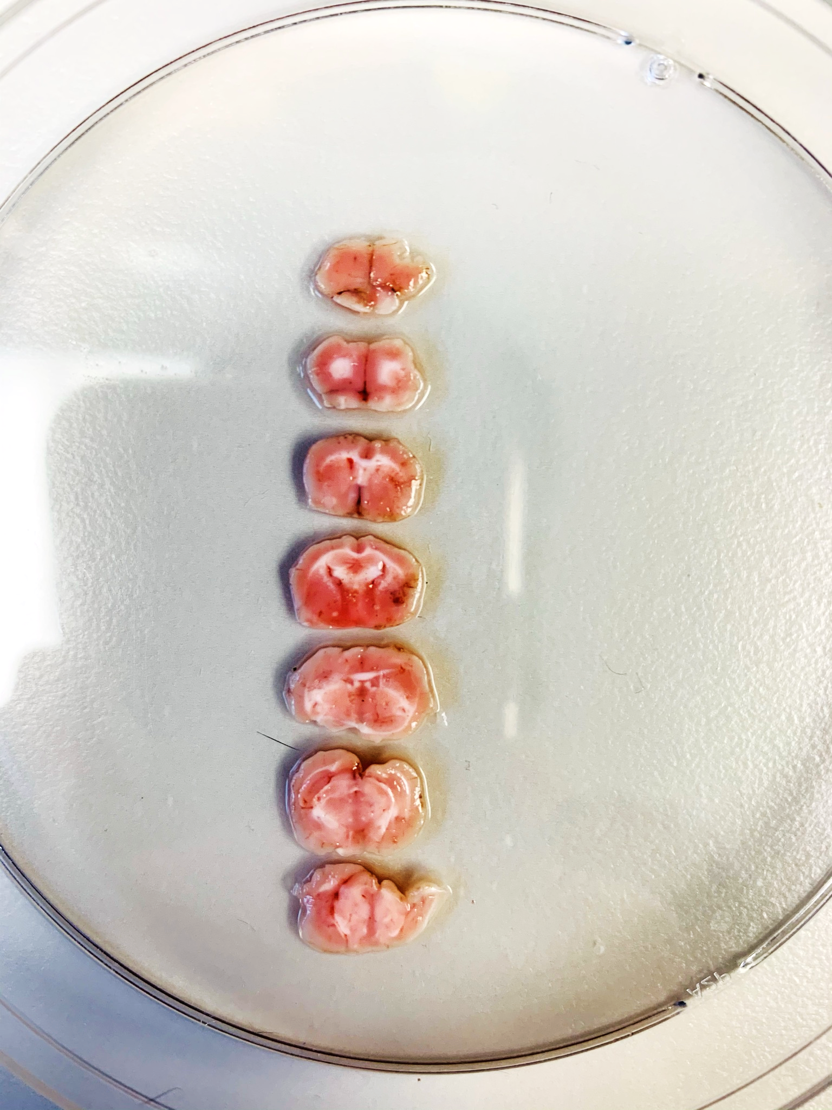
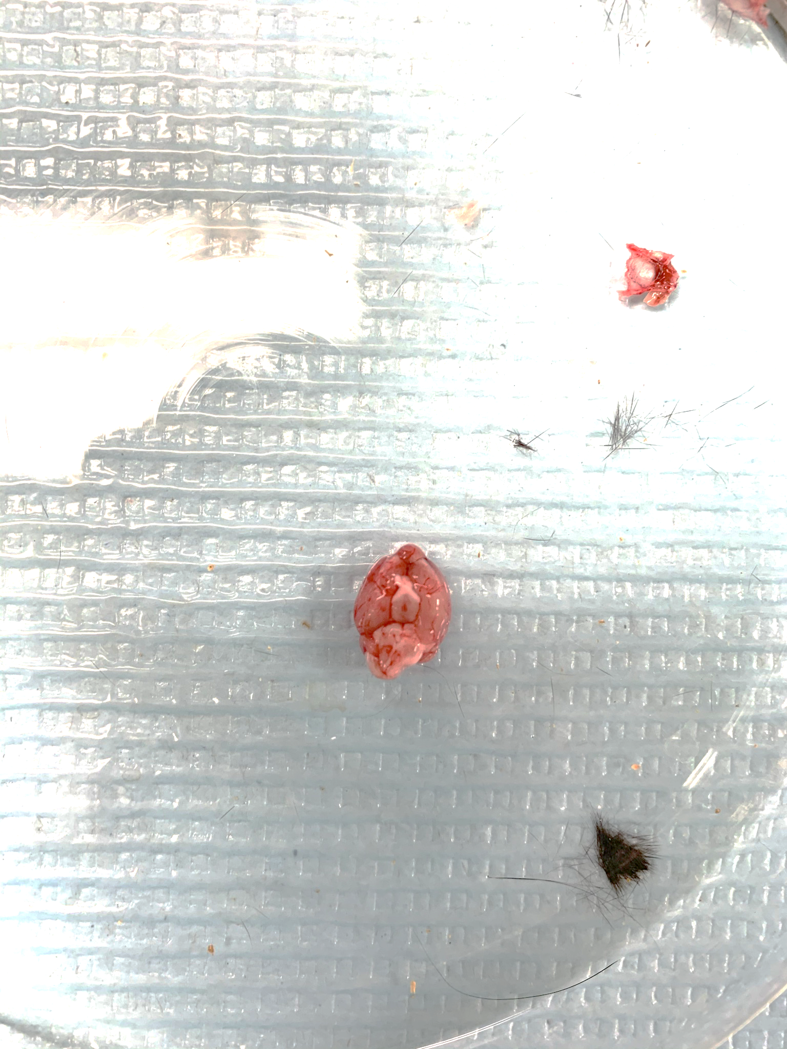
Mouse ID: AM5396
Date of surgery: 10/6/2020
Date on which found dead: 10/18/2020

Slide 4
Mouse ID: AM5396
Date of surgery: 10/6/2020
Date on which found dead: 10/18/2020
Detail View

Slide 5
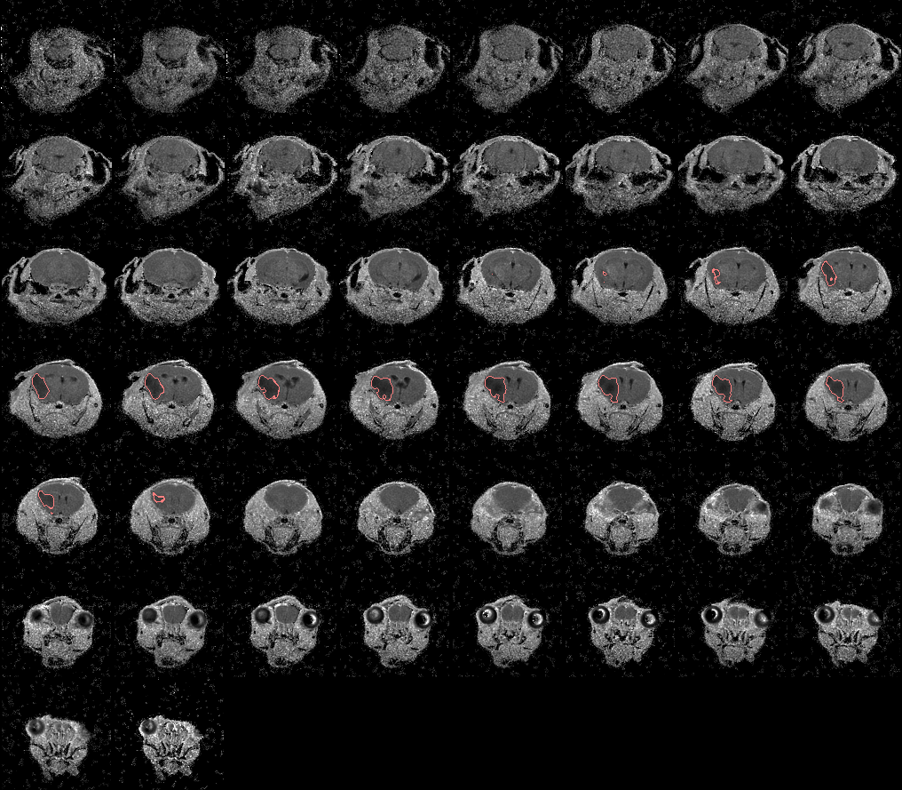
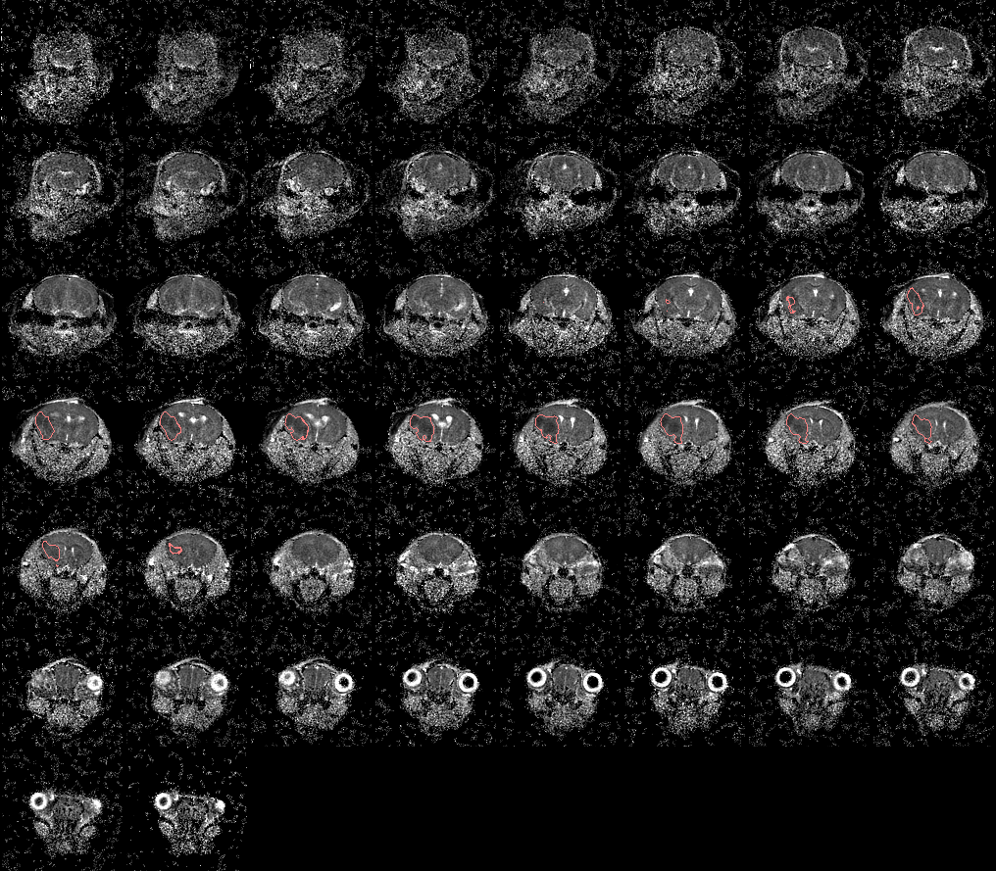
Mouse ID: AM5396
Date of surgery: 10/6/2020
Date on which found dead: 10/18/2020
TTC
T2
ADC

Slide 6
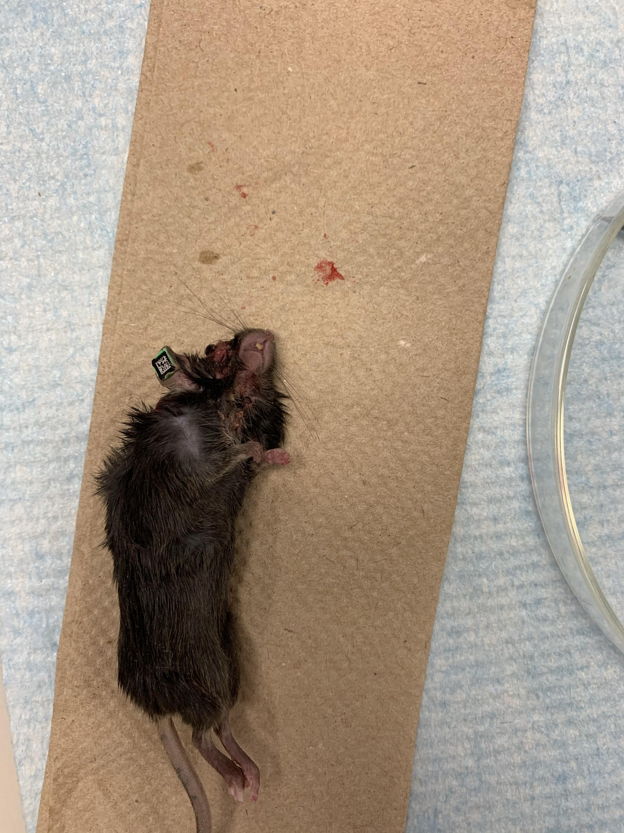
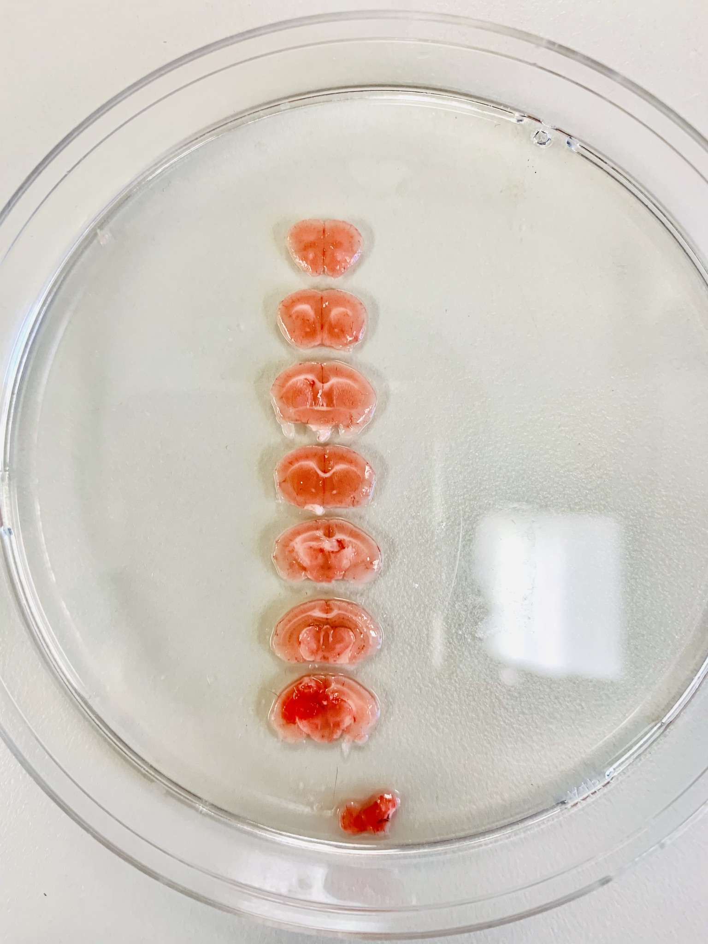
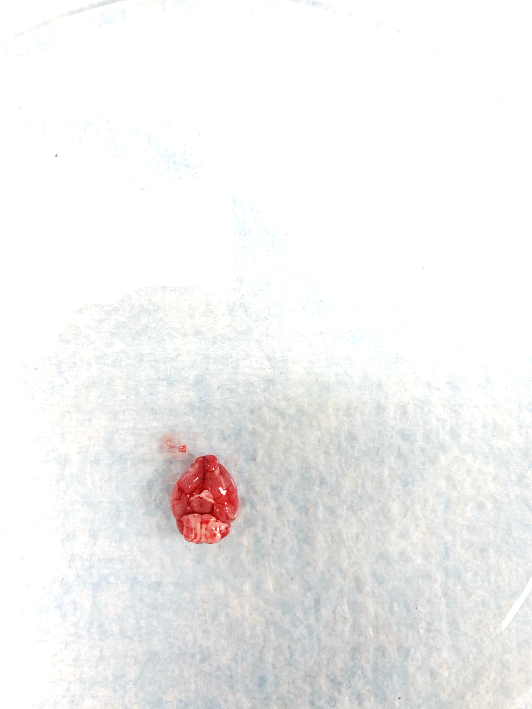
Mouse ID: VH1918
Date of surgery: 10/7/2020
Date on which found dead: 10/12/2020

Slide 7
Mouse ID: VH1918
Date of surgery: 10/7/2020
Date on which found dead: 10/12/2020
Detail View

Slide 8
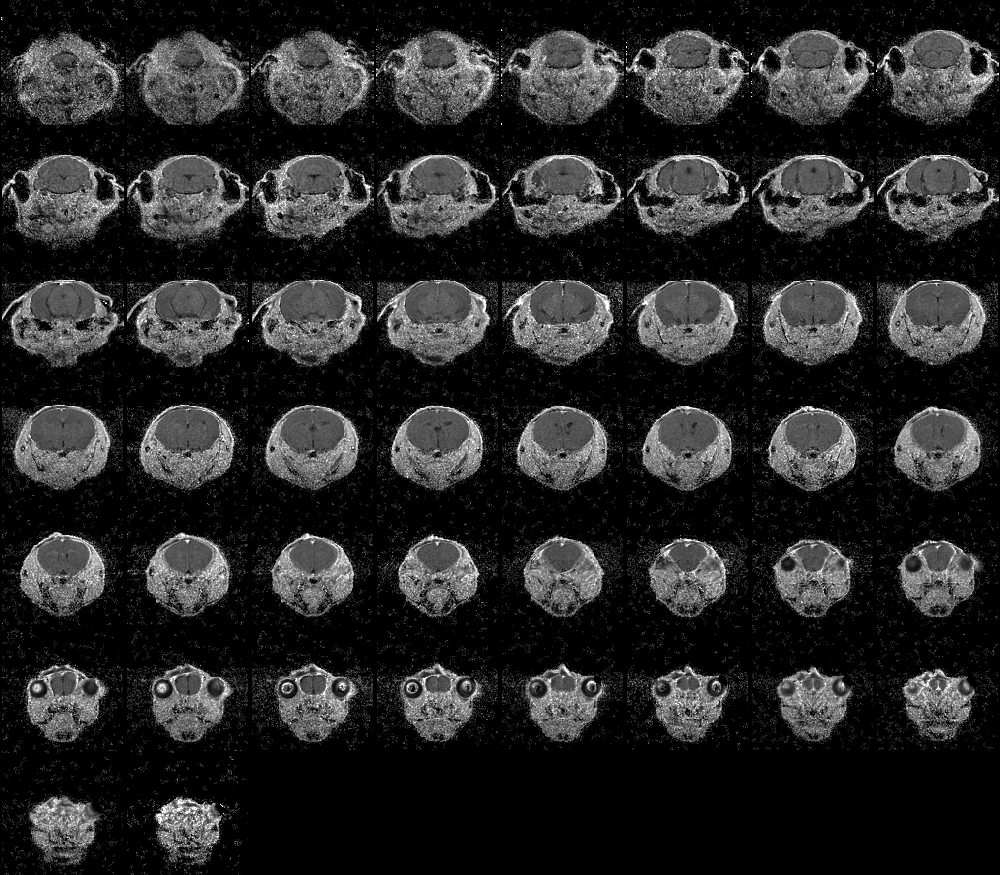
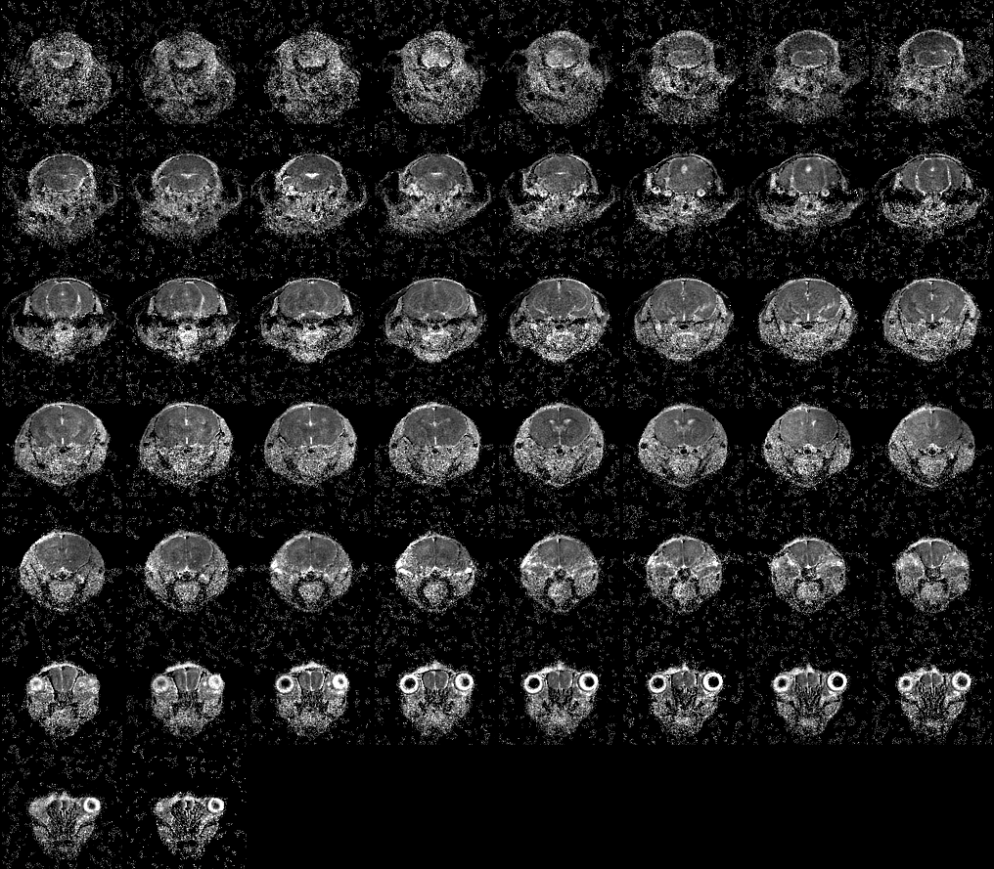
Mouse ID: VH1918
Date of surgery: 10/7/2020
Date on which found dead: 10/12/2020
T2
ADC
TTC

Slide 9
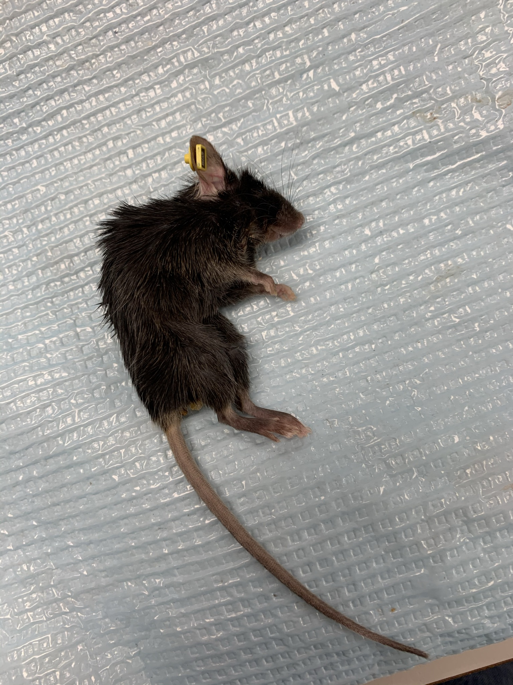
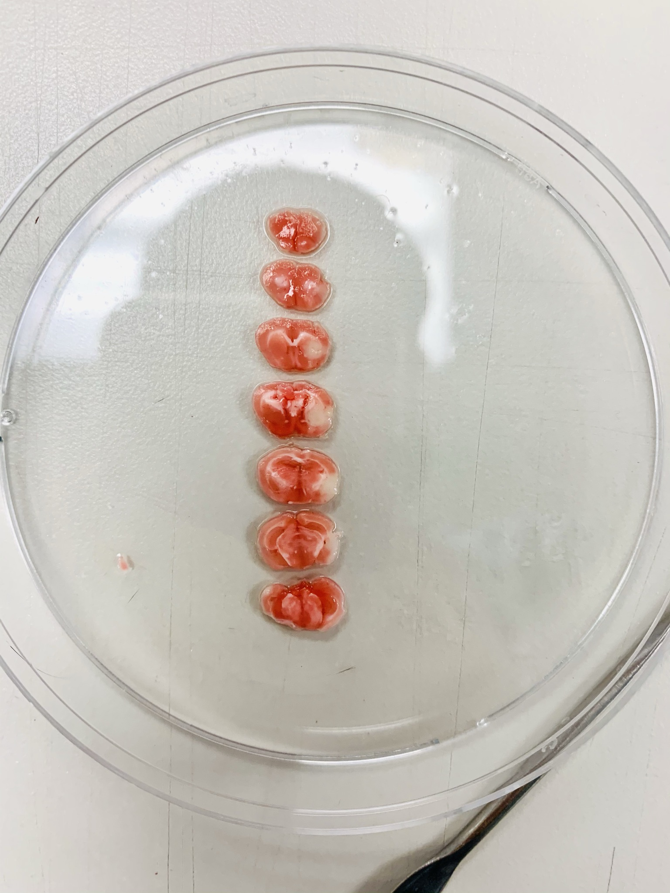
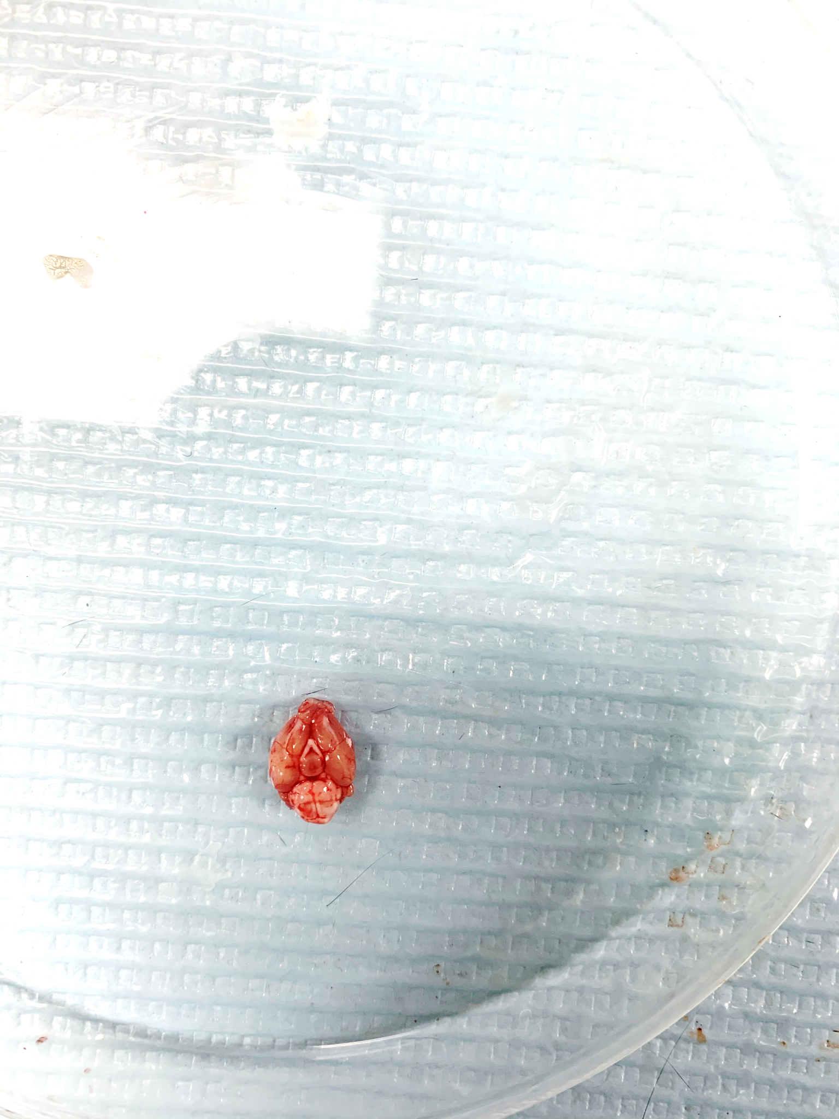
Mouse ID: AM5392
Date of surgery: 10/20/2020
Date on which found dead: 10/26/2020

Slide 10
Mouse ID: AM5392
Date of surgery: 10/20/2020
Date on which found dead: 10/26/2020
Detail View

Slide 11
University of Texas
Cases:
Ms.3325 (MM0200)
Ms.3326 (MM0206)

Slide 12
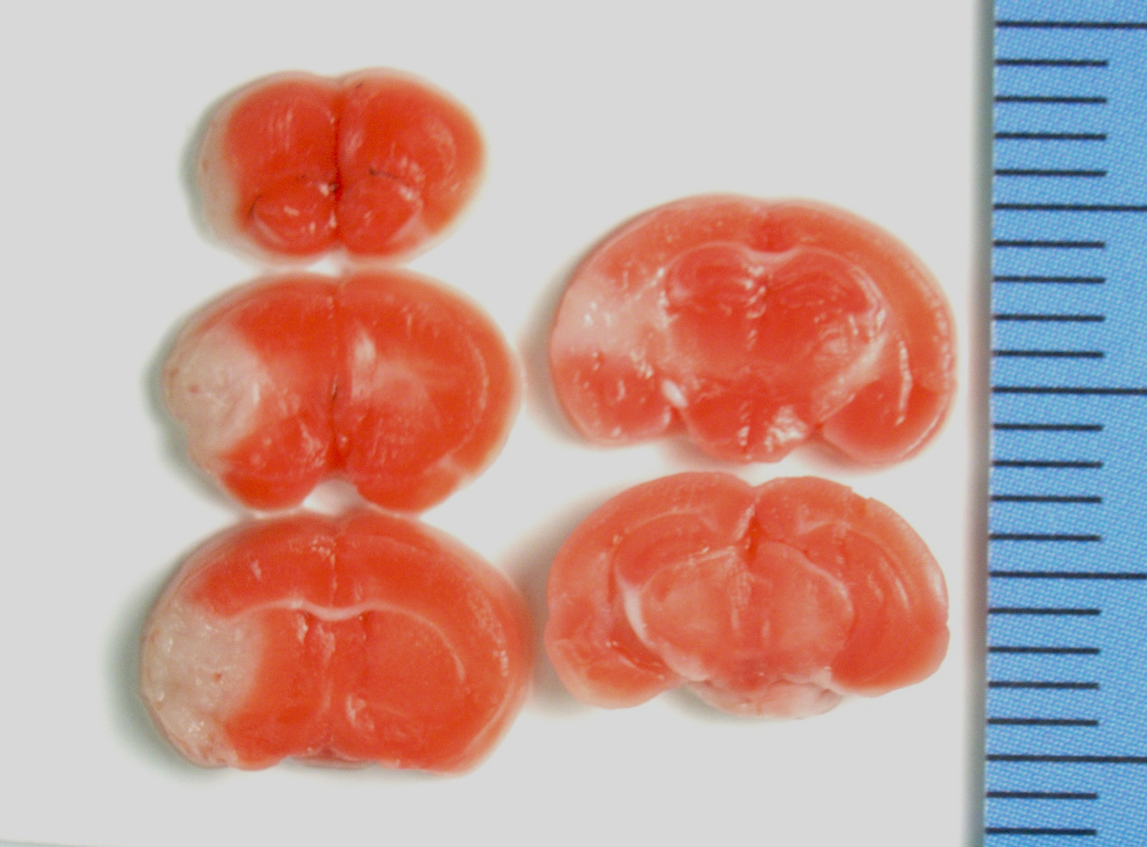
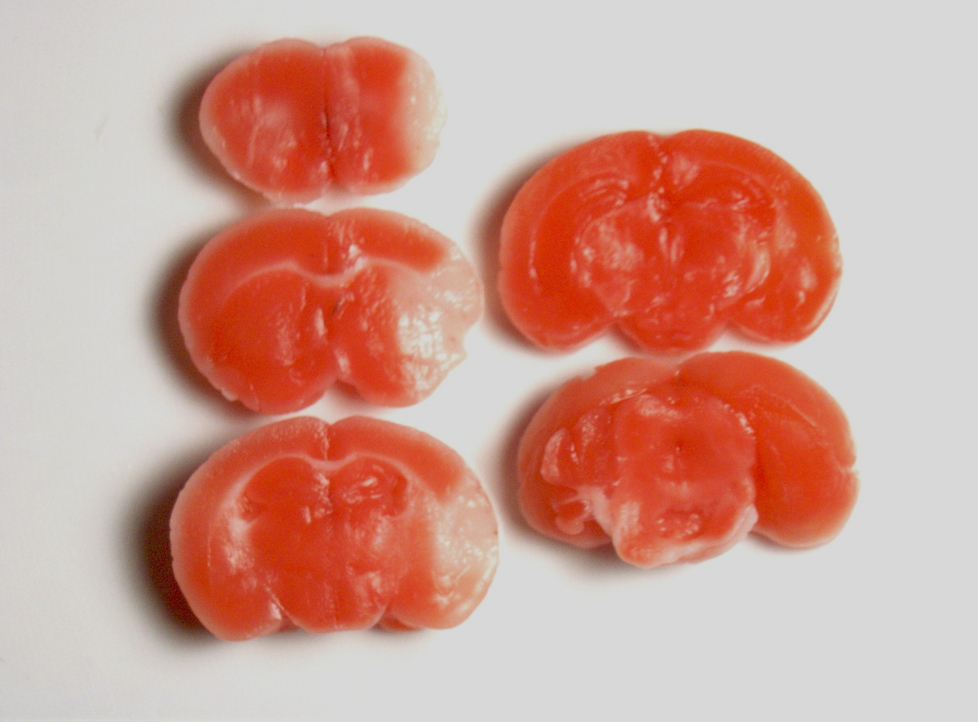
Ms.3325, MM0200 (female, 48 hours after MCAO)
Stroke volume: 31.79mm³

Slide 13
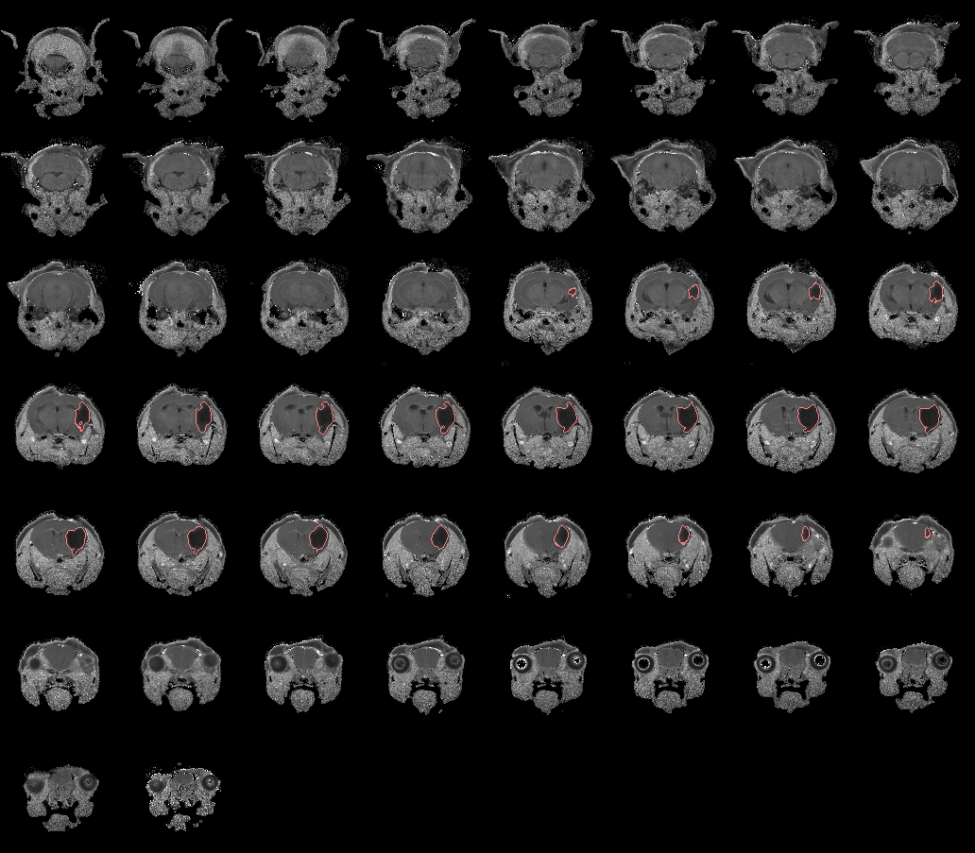
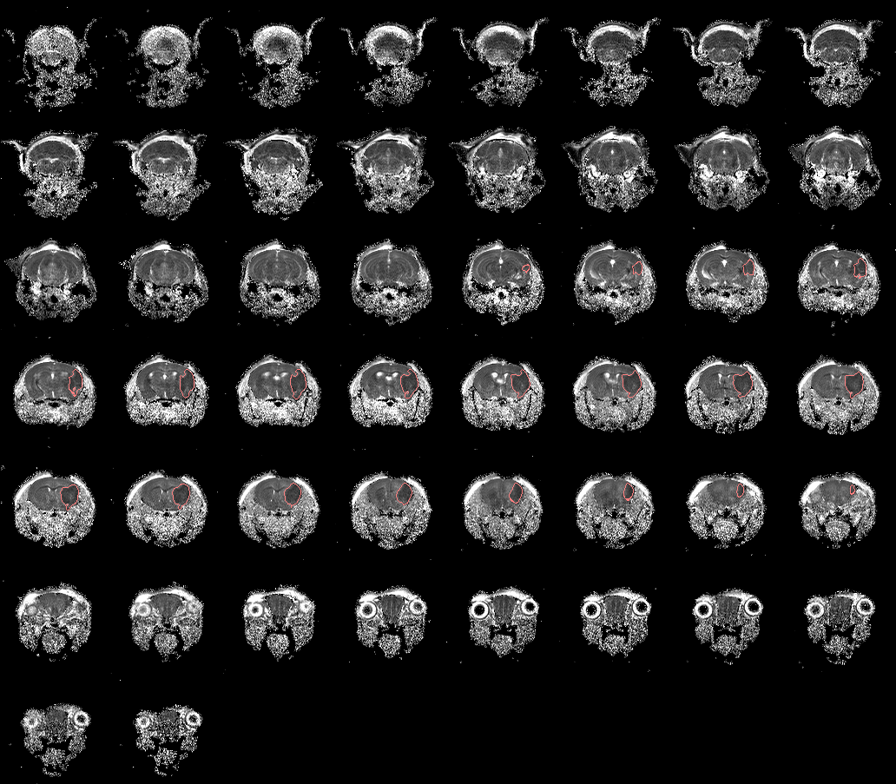
Ms.3325, MM0200 (female, 48 hours after MCAO)
T2
ADC
TTC

Slide 14
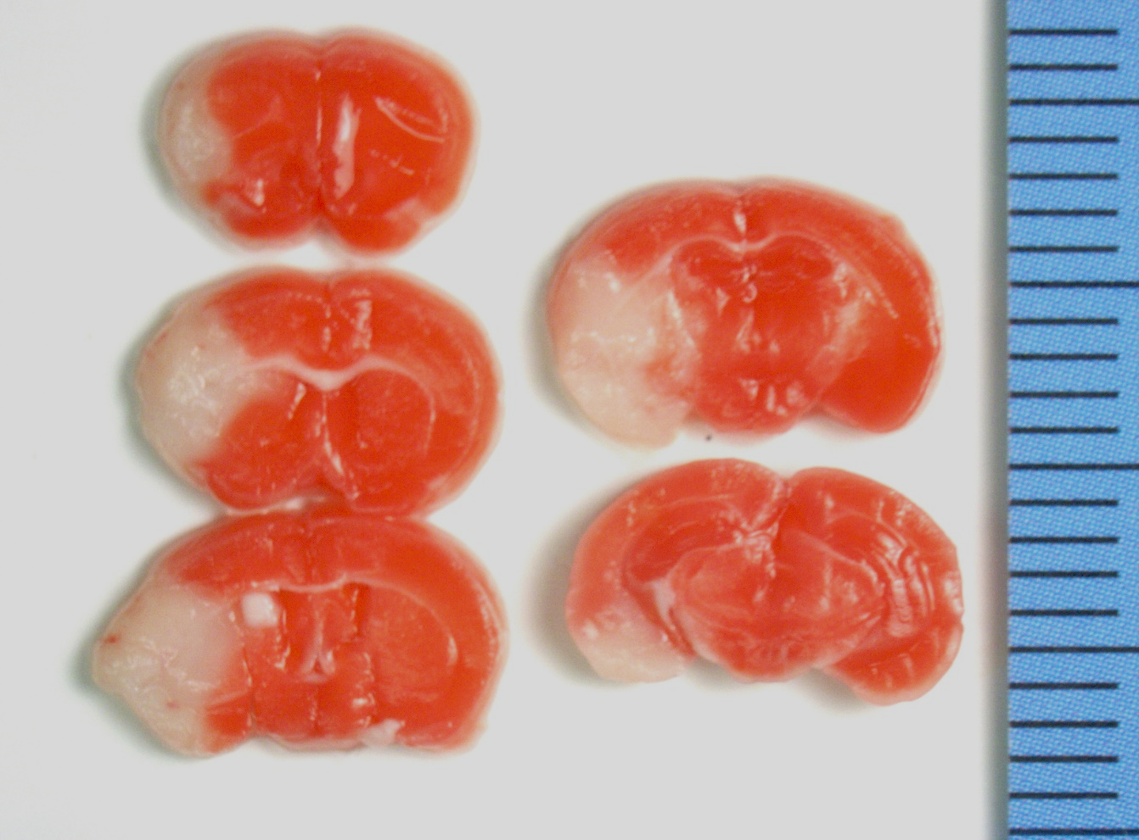
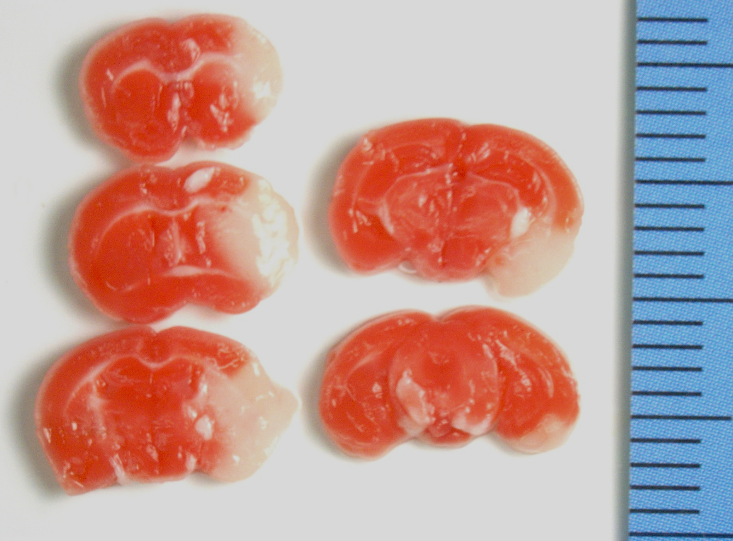
Ms.3326, MM0206 (female, 48+4 hours after MCAO)
Stroke volume: 58.07mm³

Slide 15
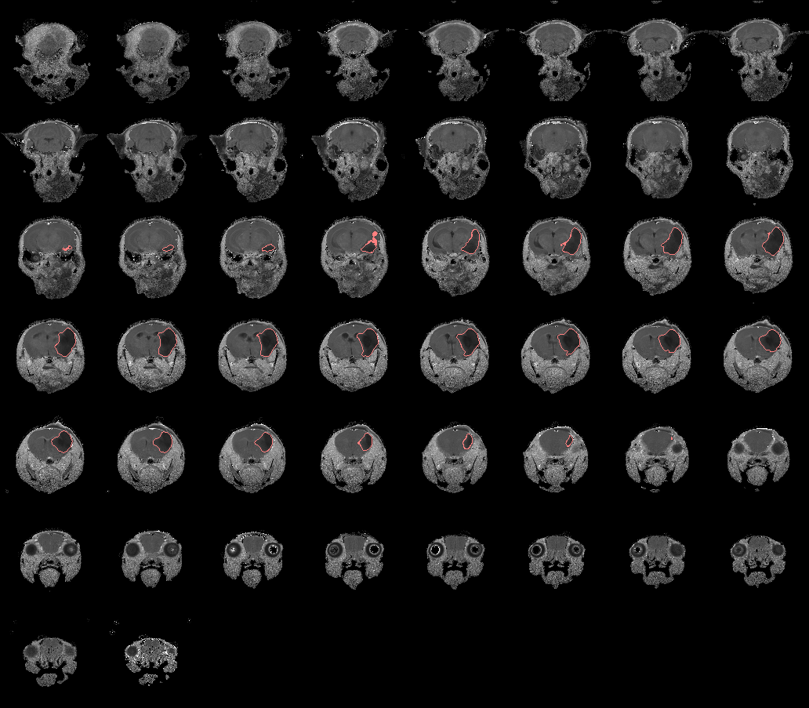
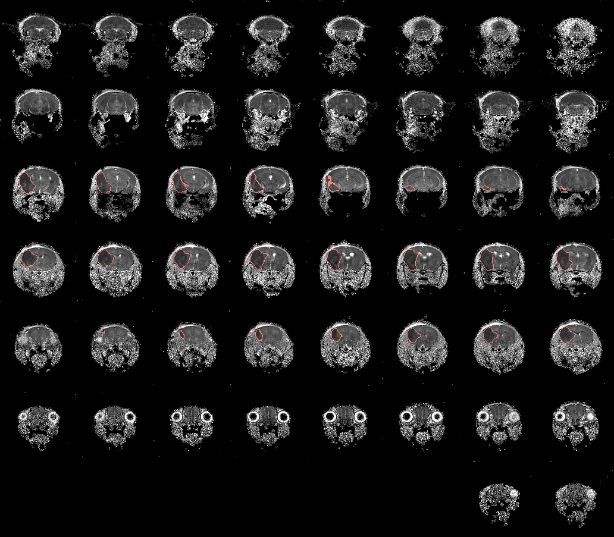
Ms.3326, MM0206 (female, 48+4 hours after MCAO)
TTC
T2
ADC

Slide 16
MGH
Cases:
QC3020
QC3021
QC3022
QC3023
QC3025

Slide 17
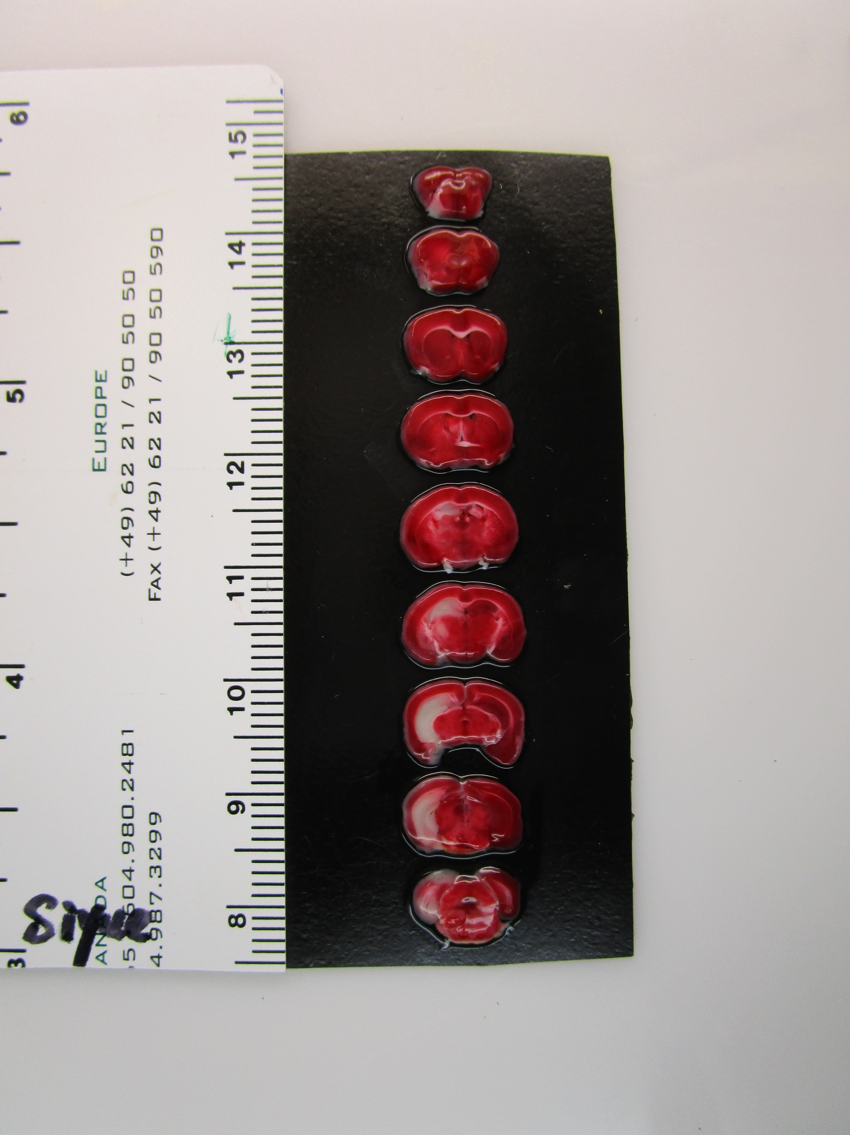
MGH – QC3020
Detail View

Slide 18
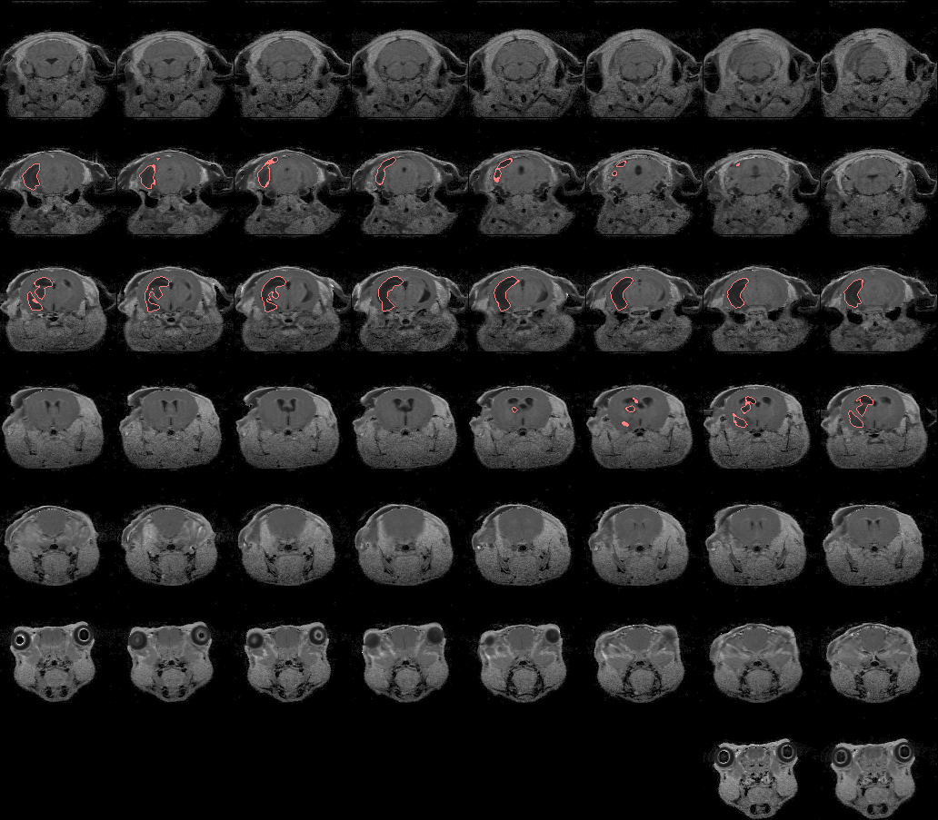
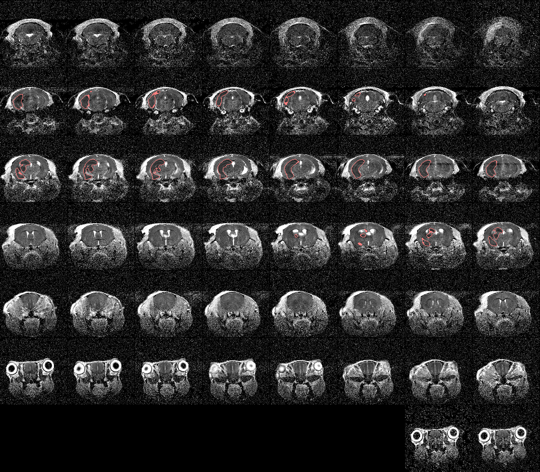
MGH – QC3020
TTC
T2
ADC

Slide 19
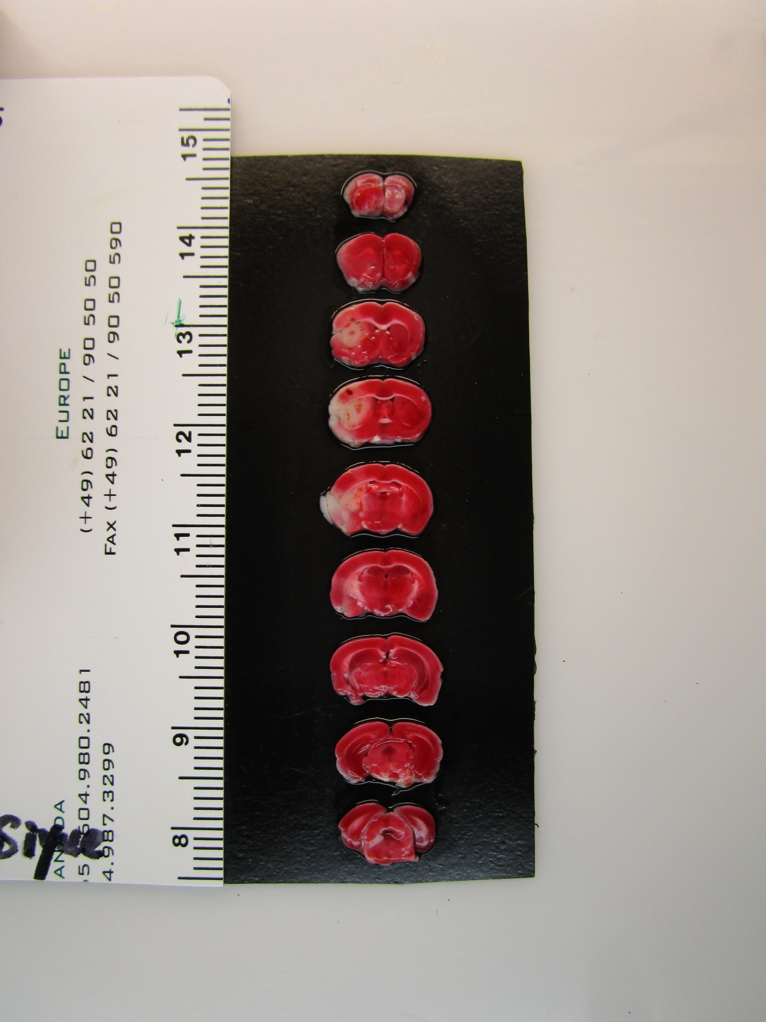
MGH – QC3021
Detail View

Slide 20
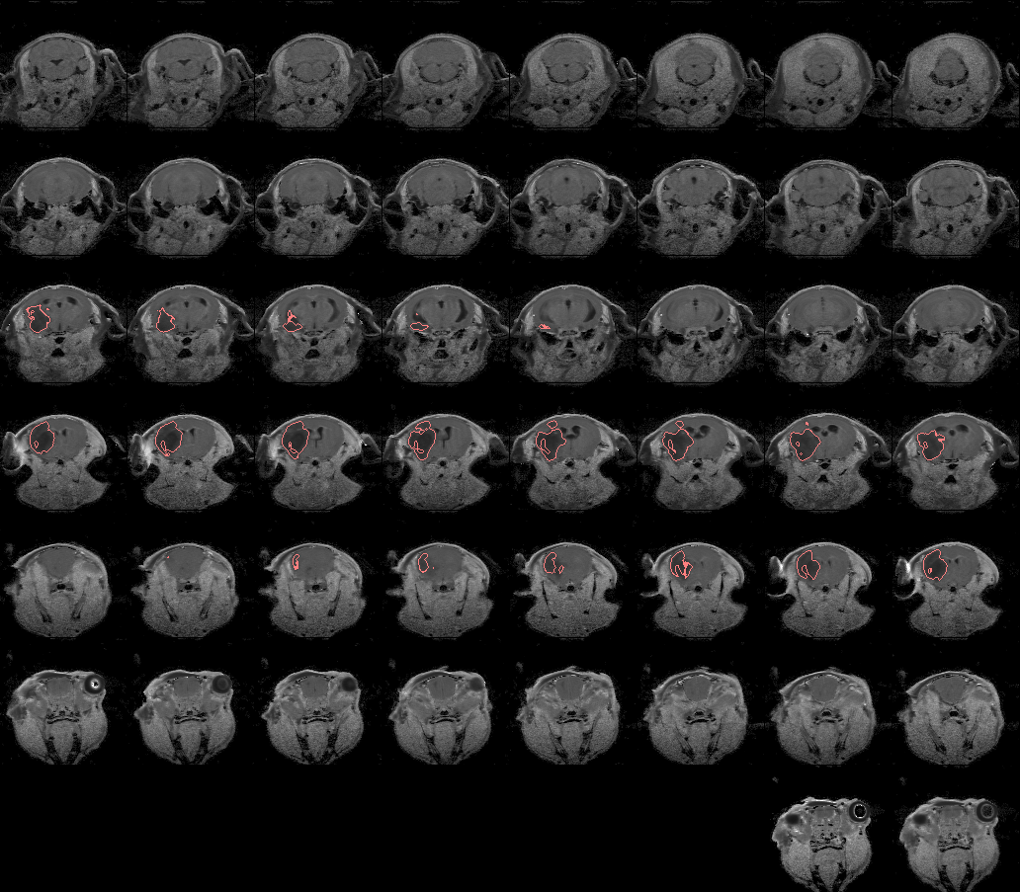
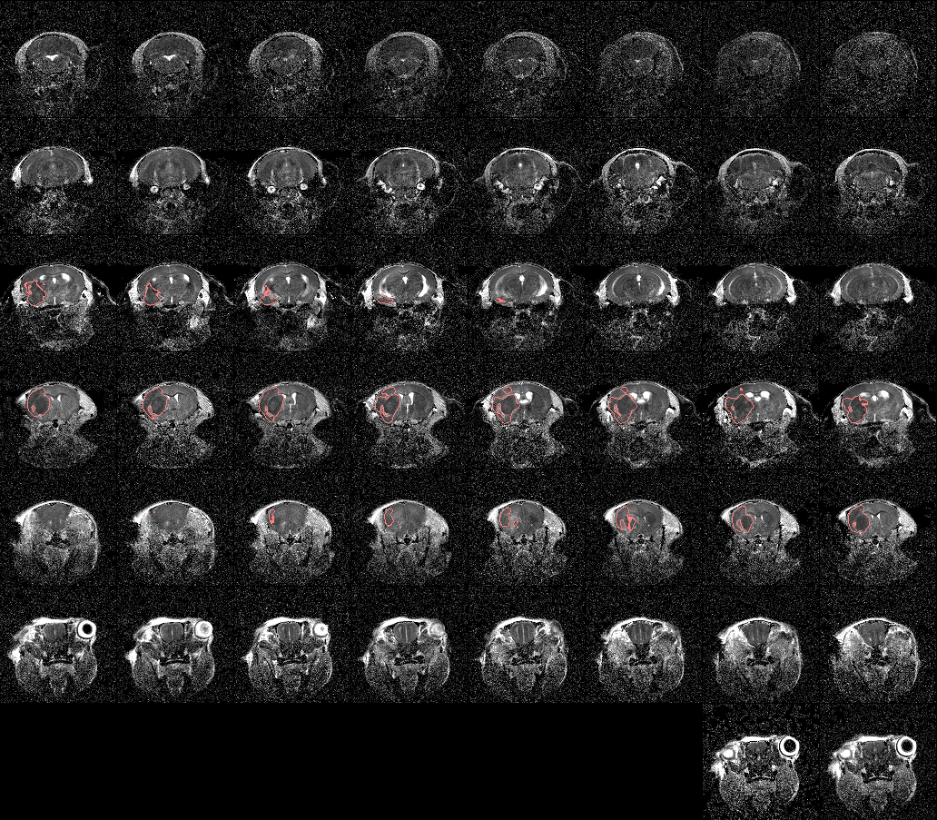
MGH – QC3021
TTC
T2
ADC

Slide 21
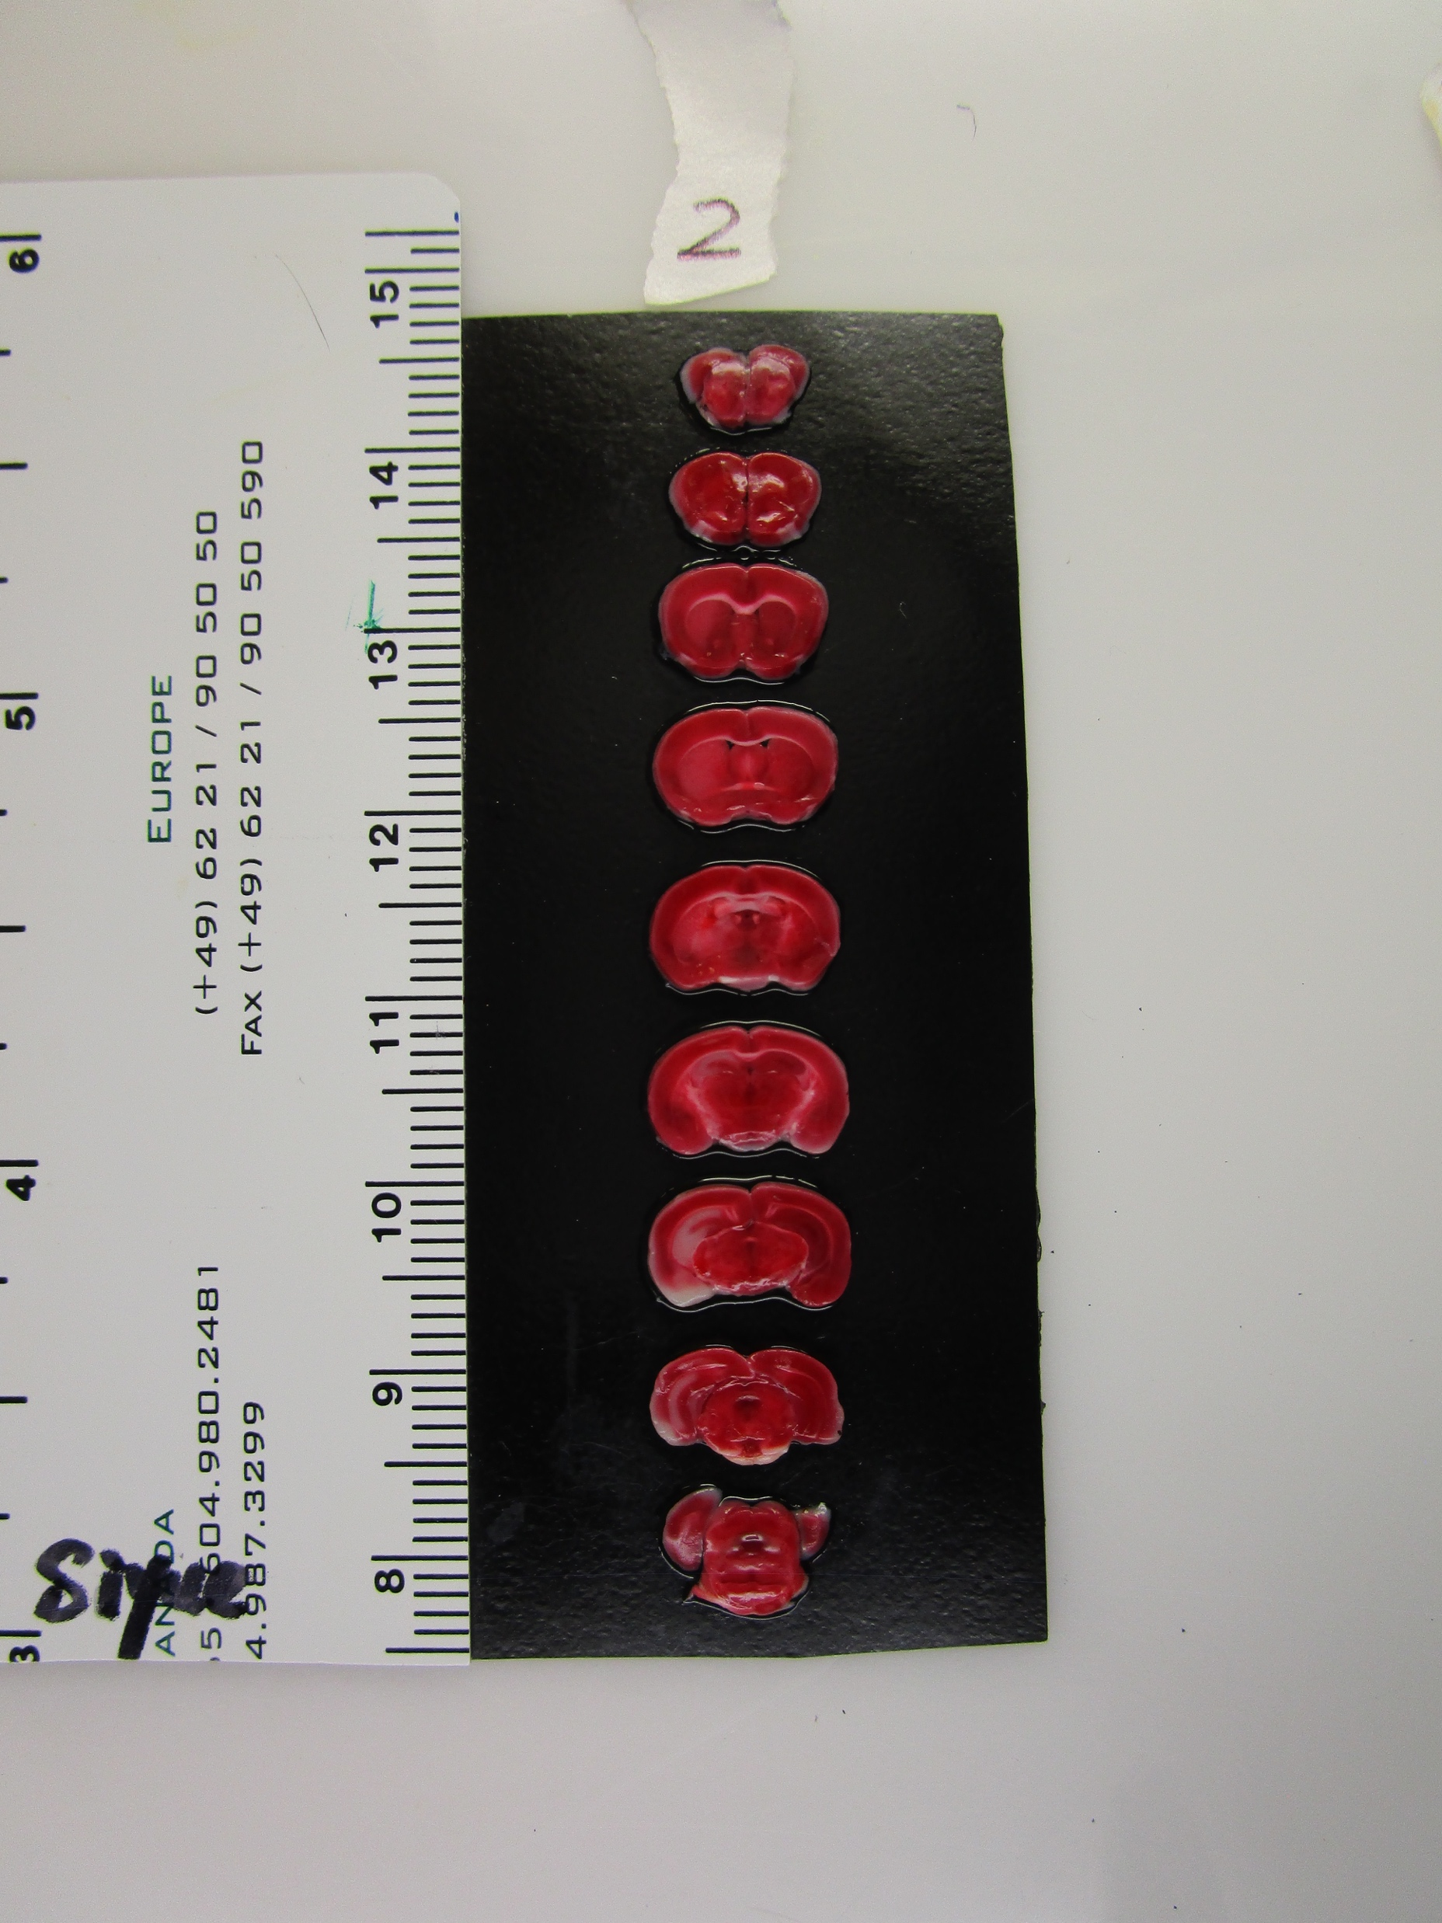
MGH – QC3022
Detail View

Slide 22
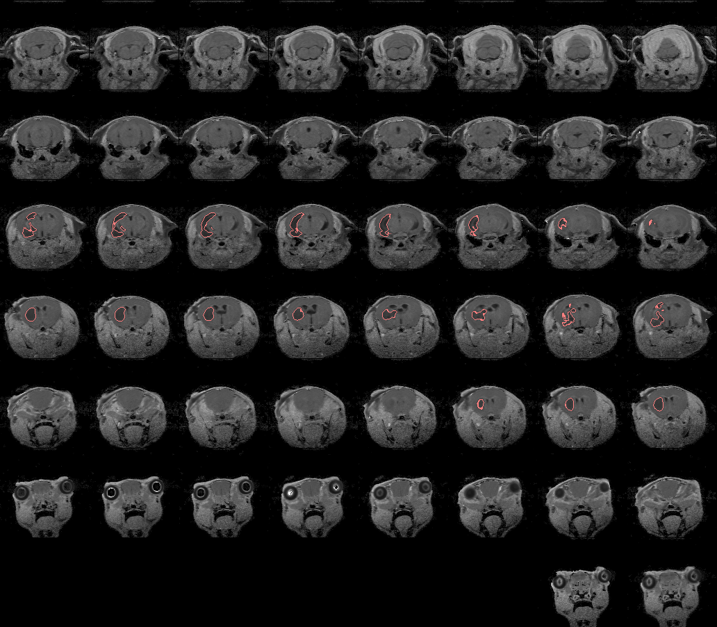
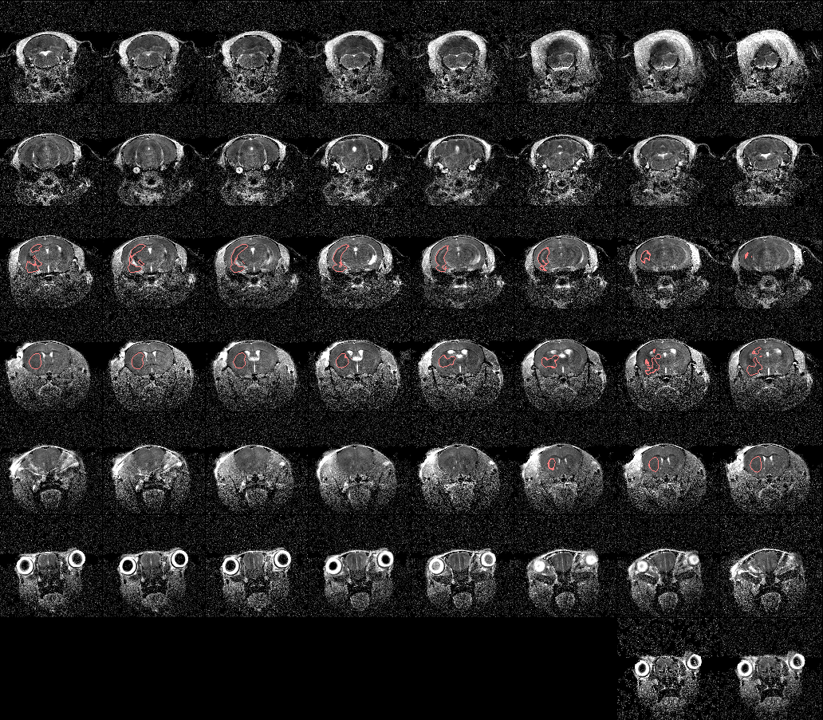
MGH – QC3022
TTC
T2
ADC

Slide 23
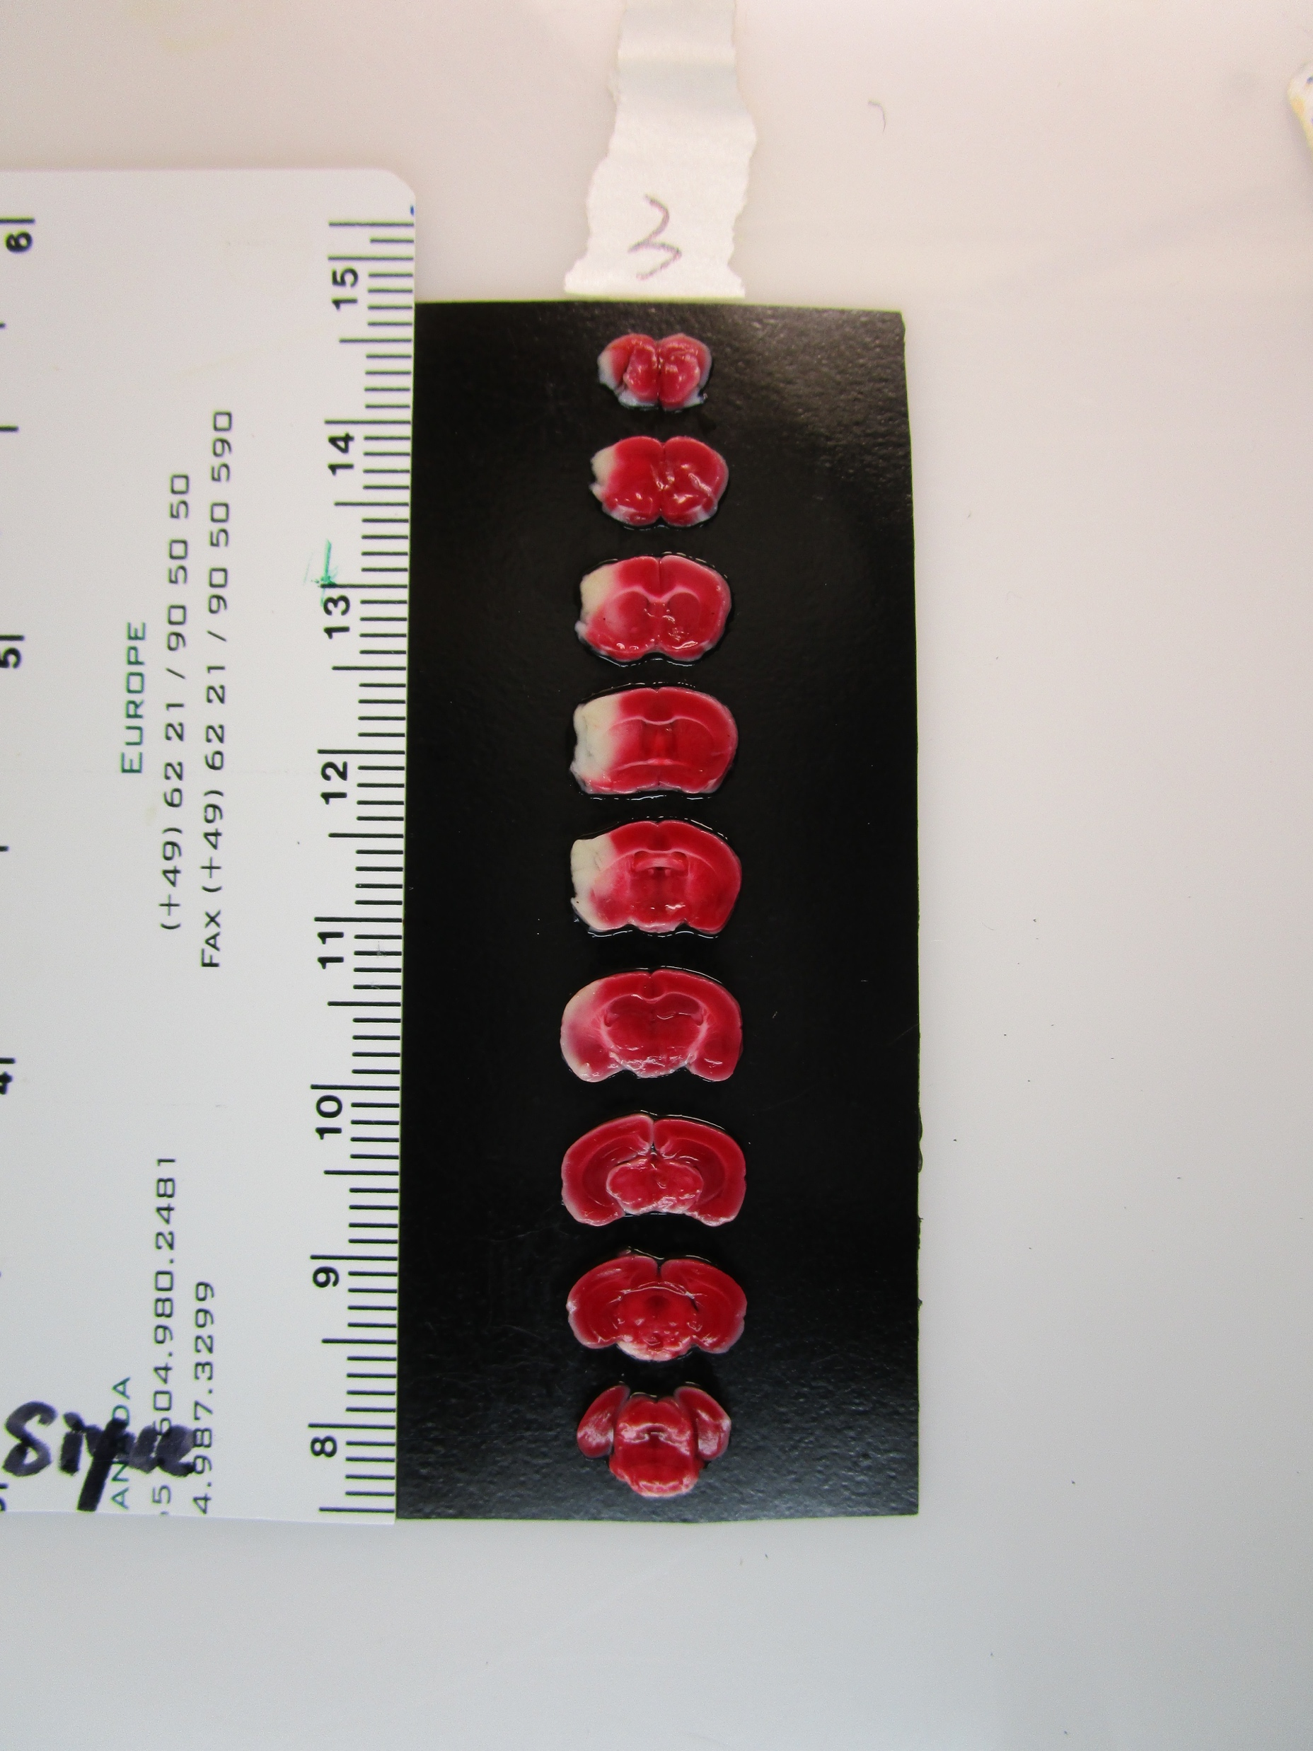
MGH – QC3023
Detail View

Slide 24
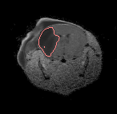
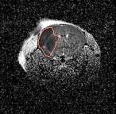
MGH – QC3023
TTC
T2
ADC

Slide 25
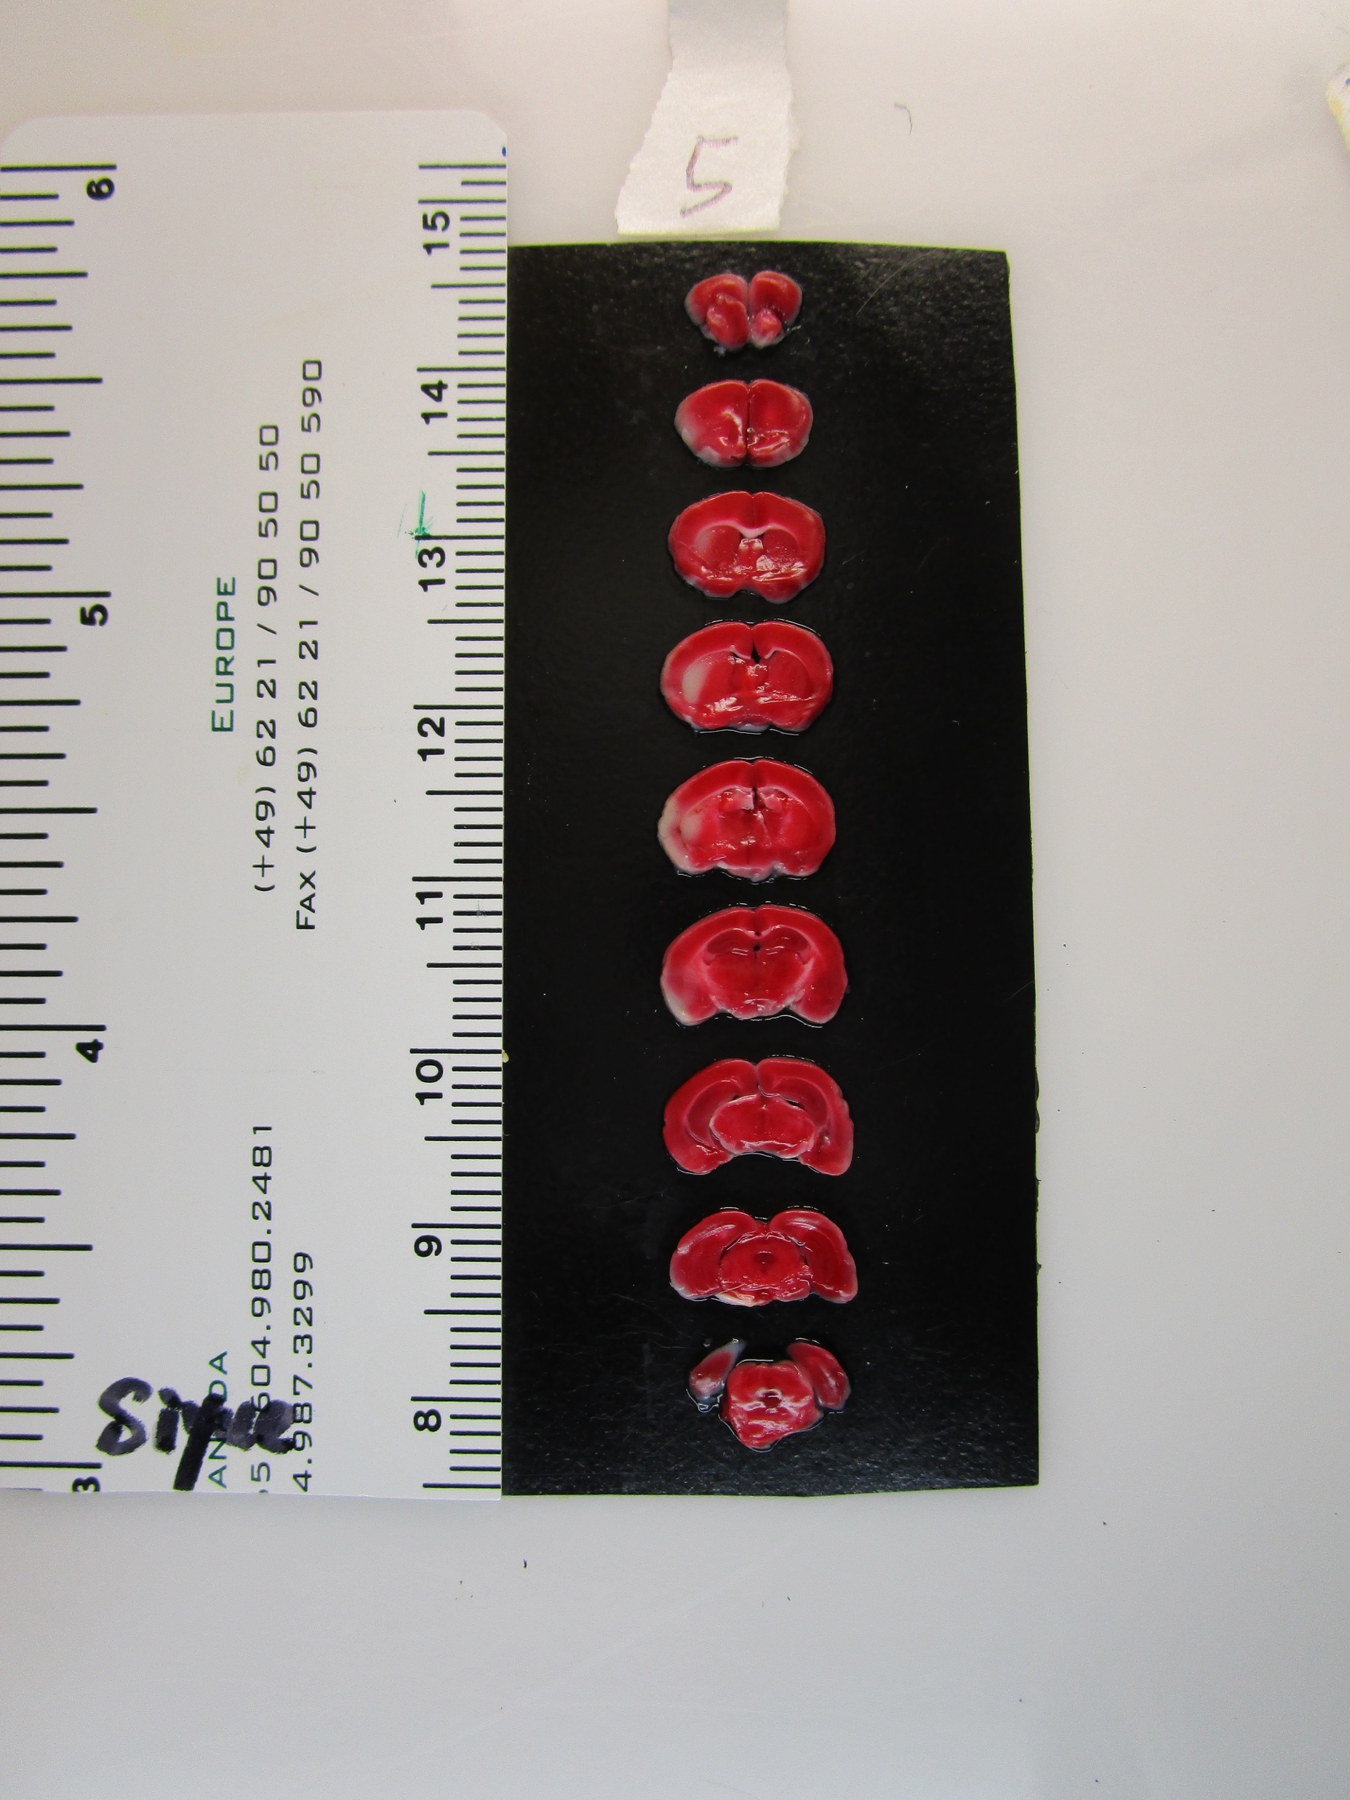
MGH – QC3025
Detail View

Slide 26
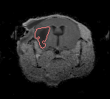
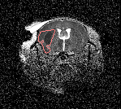
MGH – QC3025
TTC
T2
ADC

